Slide 1

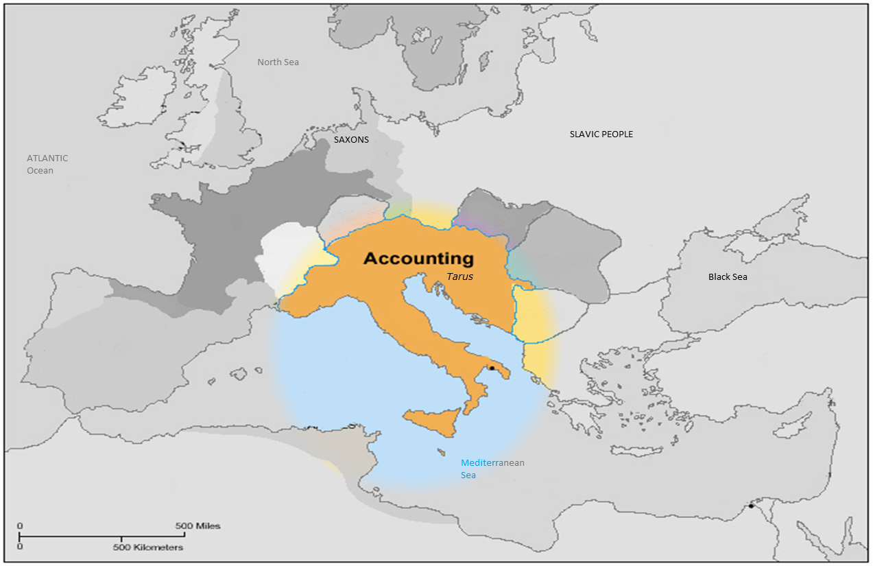
Special Delete:
Implement Tickets Listing
New Game Type System Parlay
Early Kick-Off
Email Notification
Modification, …
Report:
Win Loss Report for WON Mix Parlay Other Sport
Number Of Active Members for Bingo, Number Game, Casino
Licensee’s Peak Concurrent user
Monthly Number Game Win Loss
Negative Balance Report For Deposit User
MA Monitor Tool Enhancement, ….
Settlement:
Enhance Mix Parlay Settlement by Multiple Settle Options
Separate "Refund Last Goal" function from Refund/Refund Multiple All
Others:
Logging Enhancement By Not Using XSLT
Bet List – View Tickets Detail Of System Parlay
New Bet Type 1X2 Asia Handicap
Support Finance Dept. Performing Gross-Currency Transfer, …
What We Have Done

Slide 2
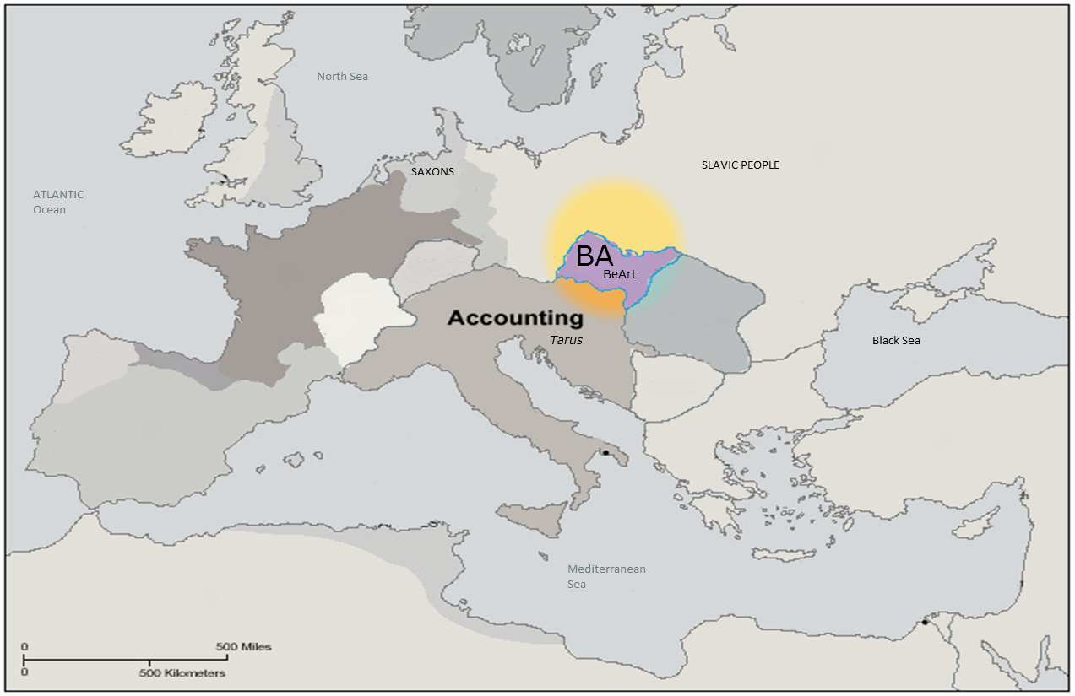
View Log For Configuration and Spread Group Setting
Report Win Loss By Licensee
Auto Mail for Daily and Monthly WL BA Base RM
New Domain admin.movebet.com
What We Have Done

Slide 3
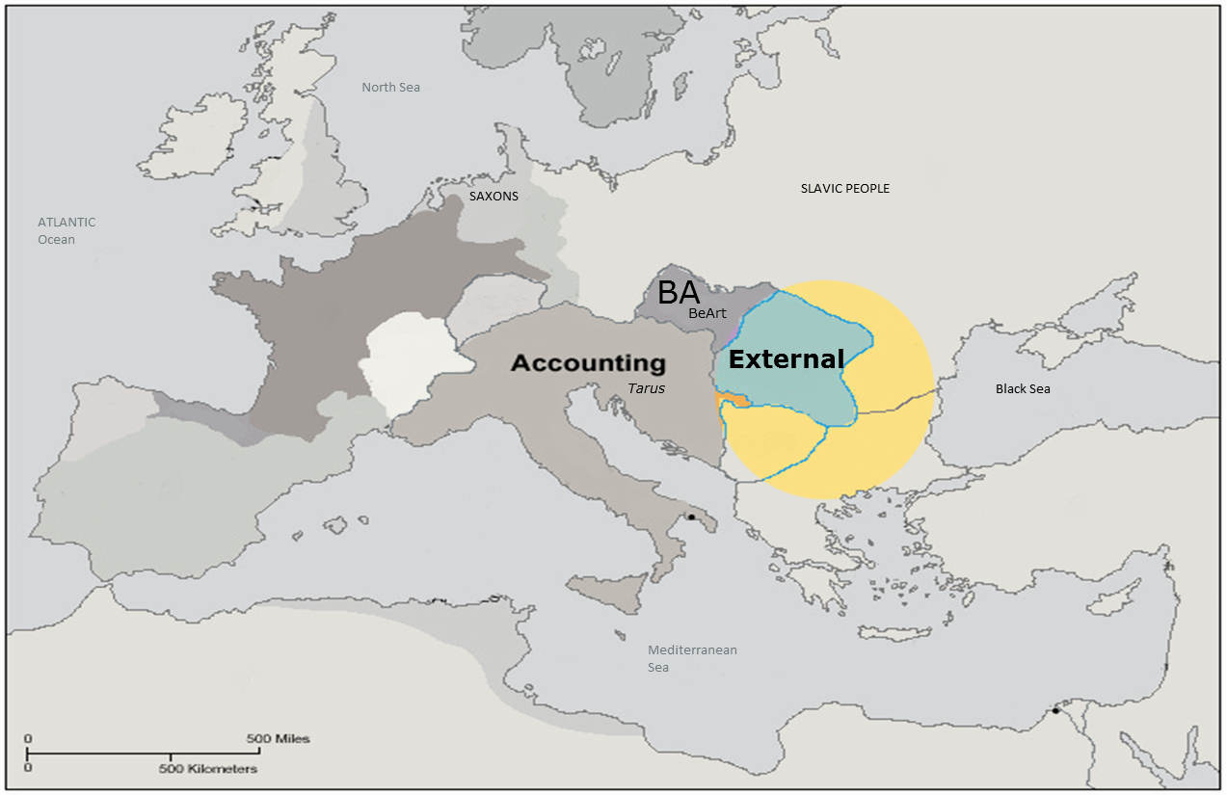
New Group Under YEN currency: YEN789 & YEN889
New Group For DDD Currency
What We Have Done

Slide 4
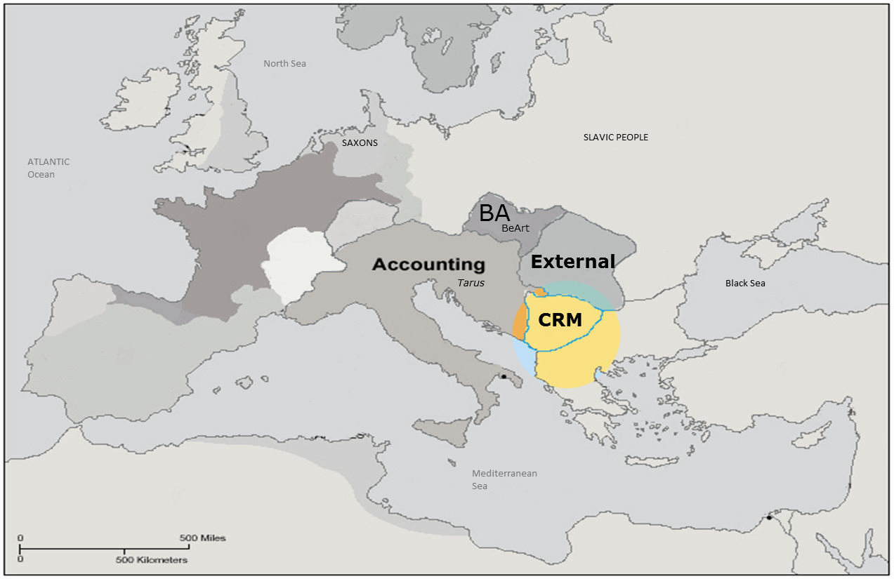
Modification, Fix bugs and Enhancement
Report Daily/Weekly Statistics
Report Casino Daily/Weekly Statistics
Support Auto Mail For Customer Complains/Enquires Report and Charting
What We Have Done

Slide 5
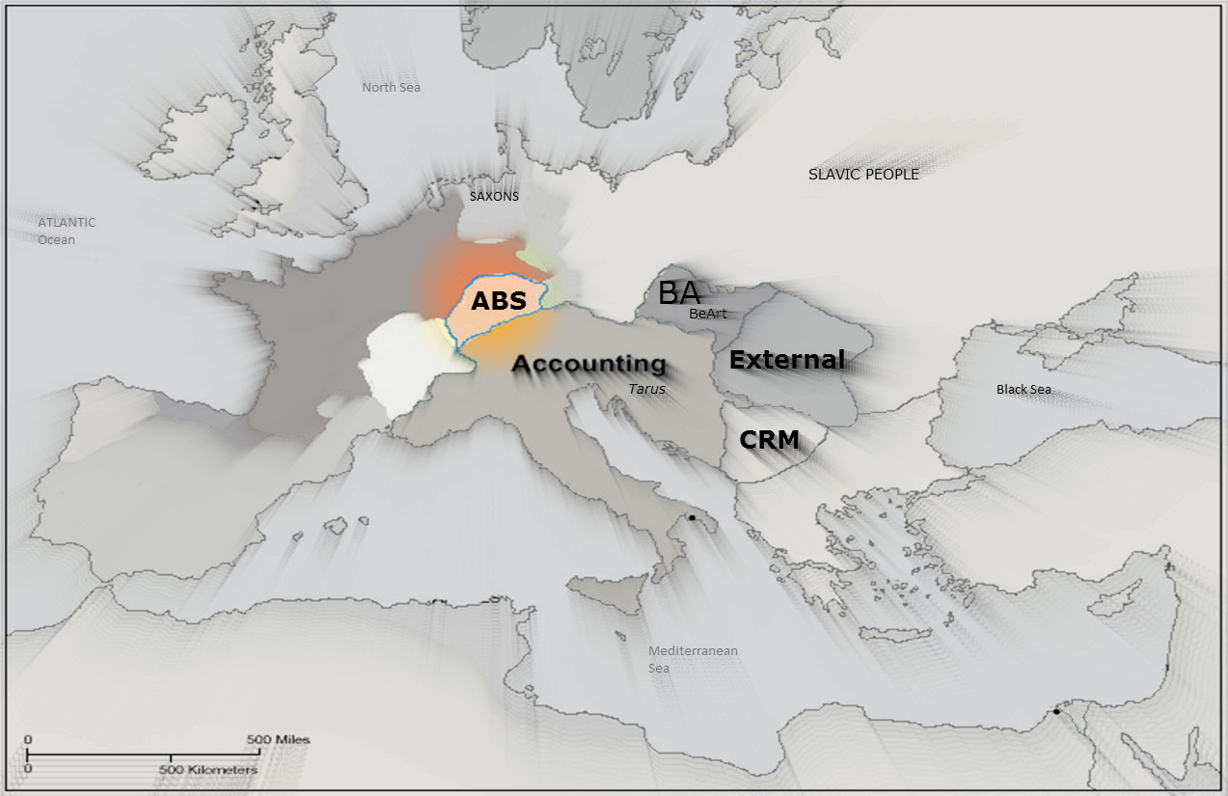
Instant Records.
Instant Report/Detail.
Summary Report.
EM & FT (Results Page)
Punter Management.
Users and Groups Policy Management.
What We Are Doing

Slide 6
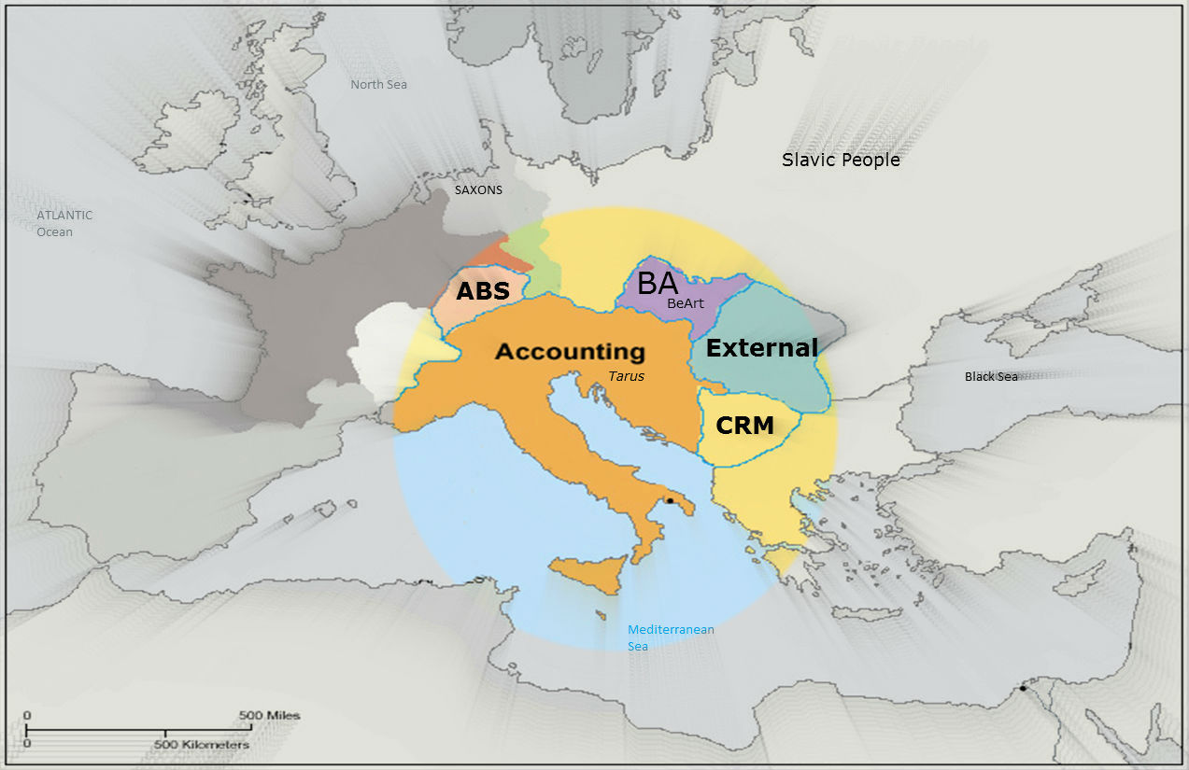




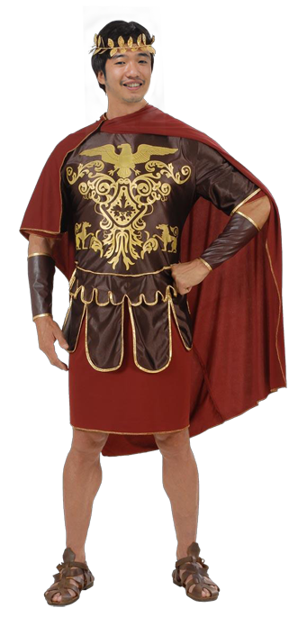

Our Warriors

Slide 7
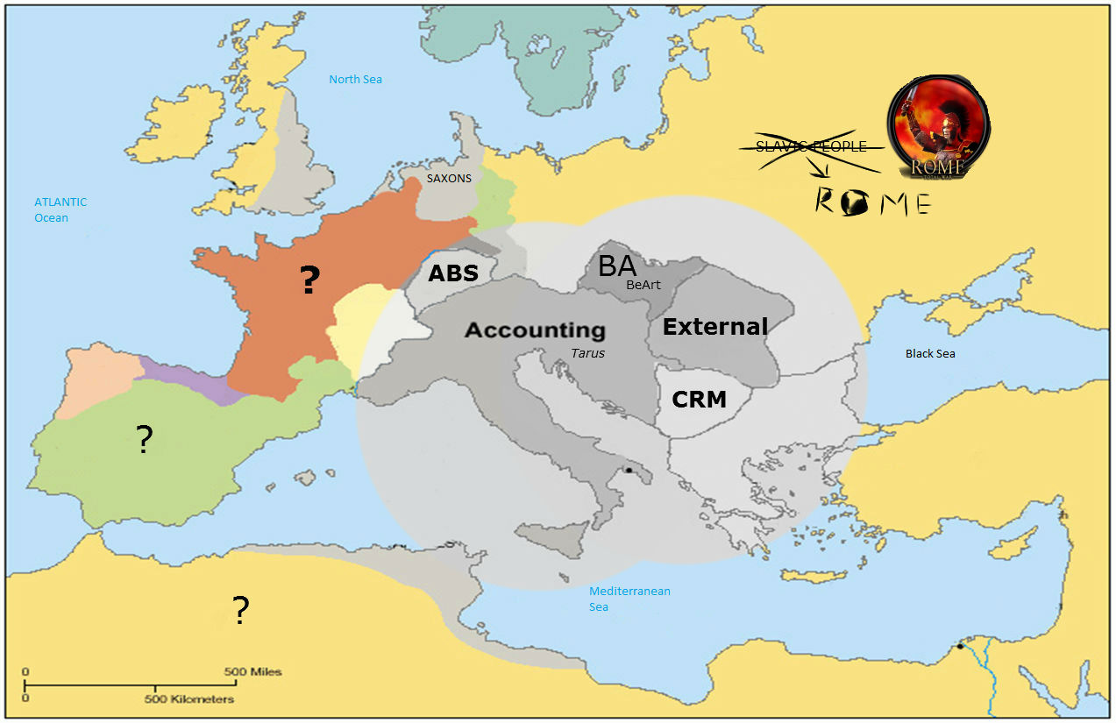
Javascript: Jquery, Knockout JS, Client Template ….
WCF
ASP .Net MVC 3, 4 (Razor Engine)
getAlbumOntop();
Our Plans

Slide 8
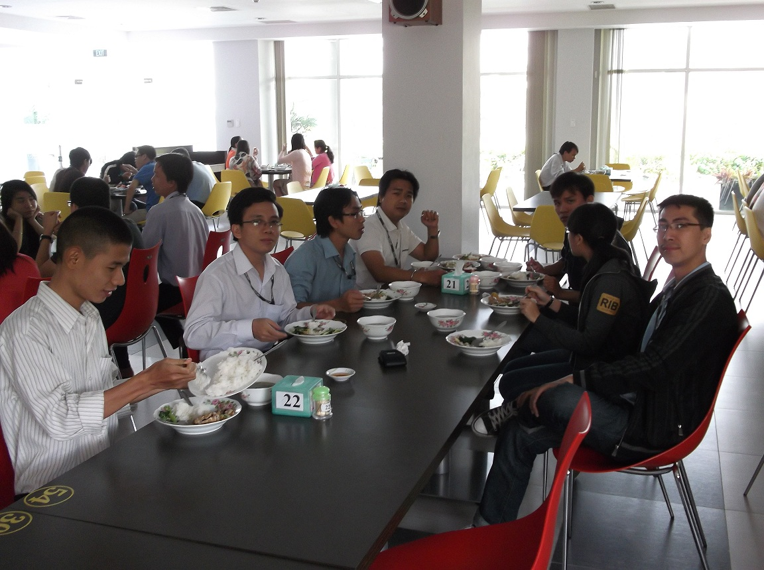
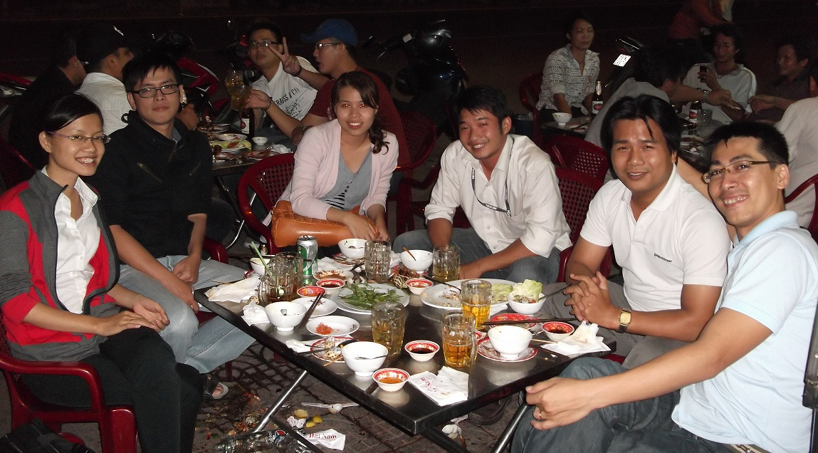

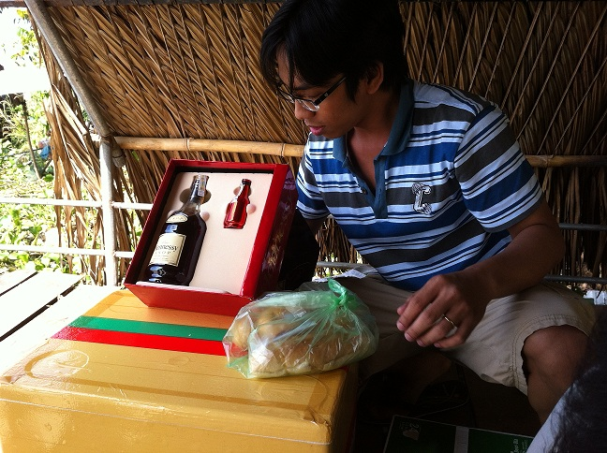
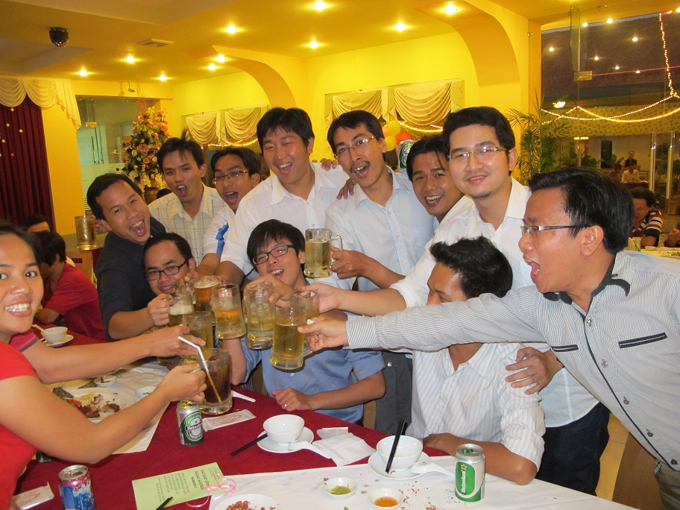

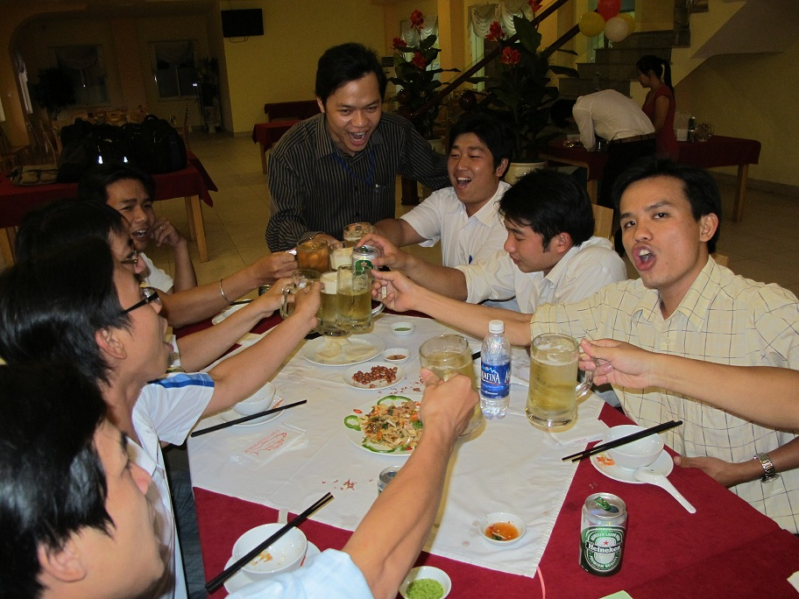
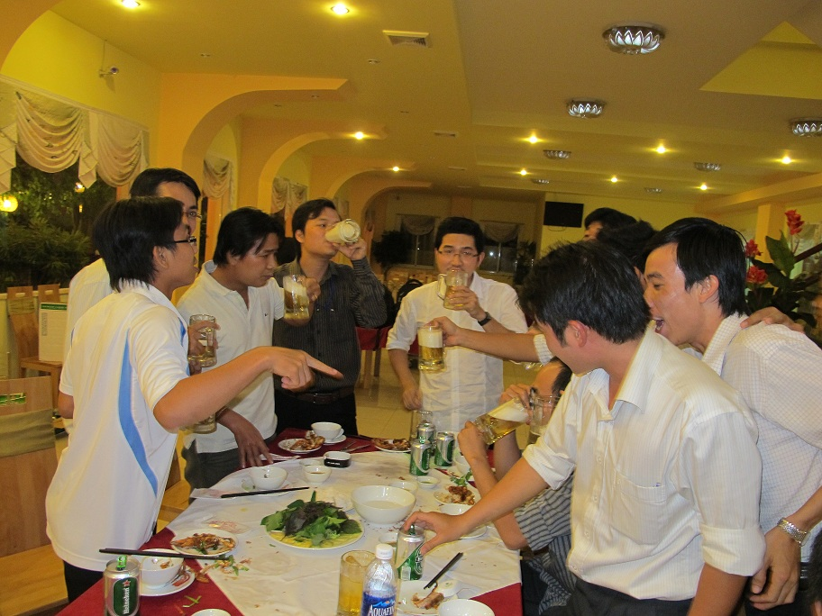
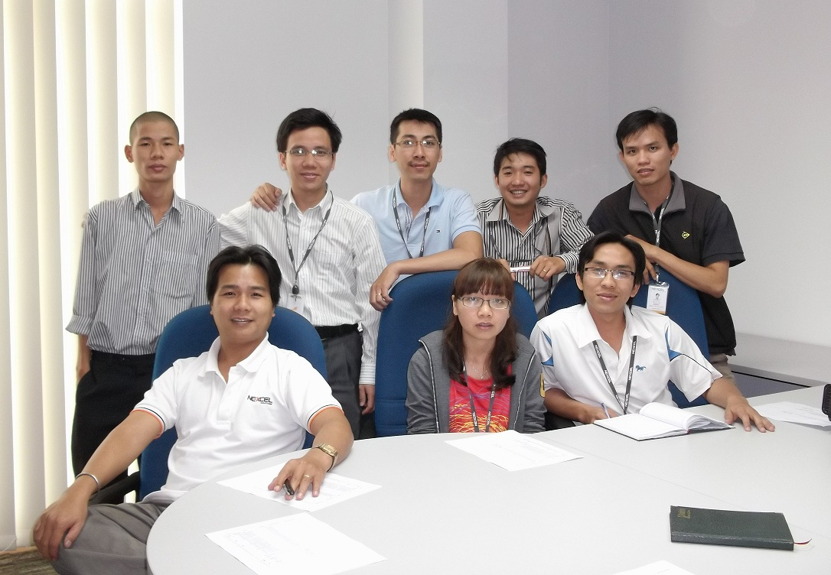
Our Gallery

